Slide 1
Tata Data Visualization: Virtual Experience Program
Task 4: Communication Insights and Analysis
Presented By,
Nisha A

Slide 2
Table of Content
Business Problem Understanding
Explanatory Data Analysis Using Python
Data Visualization Using Tableau
Insights & Recommendation

Slide 3
Business Problem understanding
An online retail store needs to review its data and provide insights that would be valuable to the CEO and CMO of the business. The business has been performing well, and the executives want to analyze the trends and the breakdown by different categories to clarify how the revenue is being generated and the main factors affecting the online store
The given dataset contains attributes and aspects of their behavior on the Online Retail Store
Retail Store Behavior – Invoice No, Stock Code, Description, Quantity, Invoice Date, and Unit Price
Customer Behavior – Customer ID and Country

Slide 4
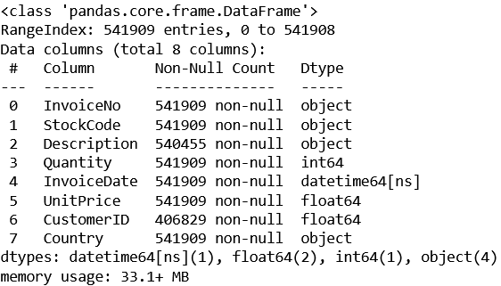
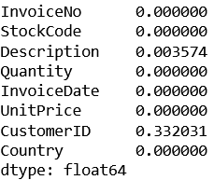
Explanatory Data Analysis
Info of the Data
Data has 7 features with 541909 entries
Invoice No, Stock code, Description & Country are object datatype
Quantity is int datatype
Unit price & Customer ID are float data type
Feature Invoice Date is a Datetime data type
Null Value Check
Feature Description and Customer ID has Null values, since the count of Null values is smaller in percent compare to the total value count, we are dropping the missing value records

Slide 5
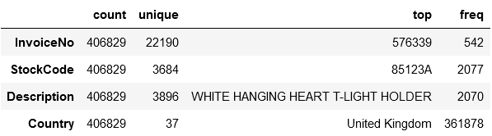
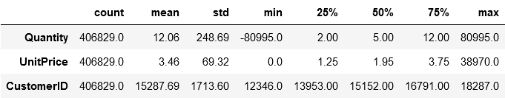
Explanatory Data Analysis
Descriptive statistics (Categorical Feature) Descriptive Statistical (Numeric Feature)
The top sold category is White hanging heart T-Light holder
Quantity and Unit Price has negative values, which indicates the presence of anomalies, we treated the anomalies with Median value imputation

Slide 6
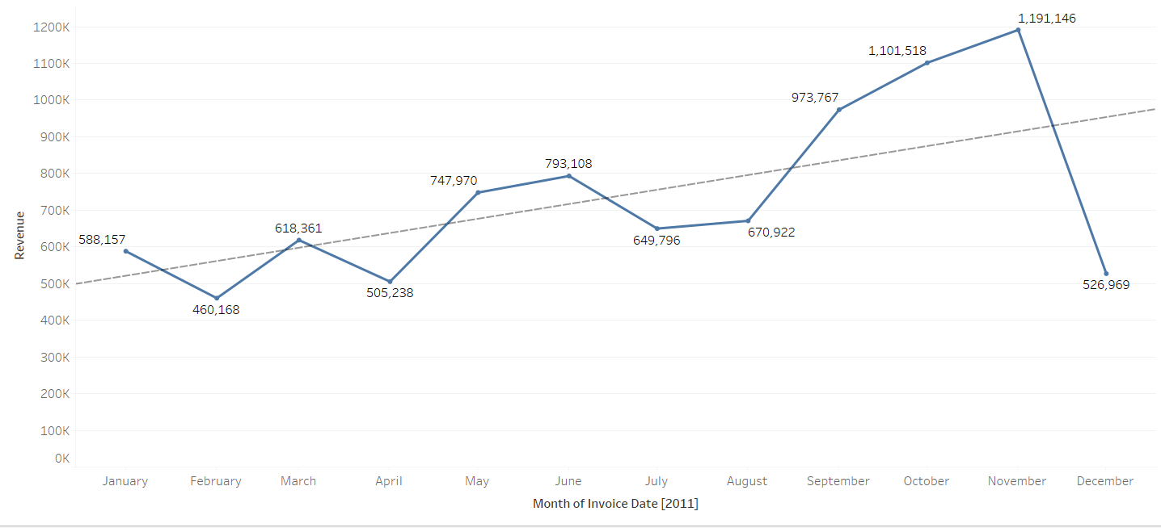
Data Visualization
Monthly Revenue - 2011
The trend of the sum of Revenue for Invoice Date Month. The data is filtered on Invoice Date Year, which keeps the 2011
Year 2011 shows an increasing trend and the highest revenue made month is November and the month December shows a slight decrease trend

Slide 7
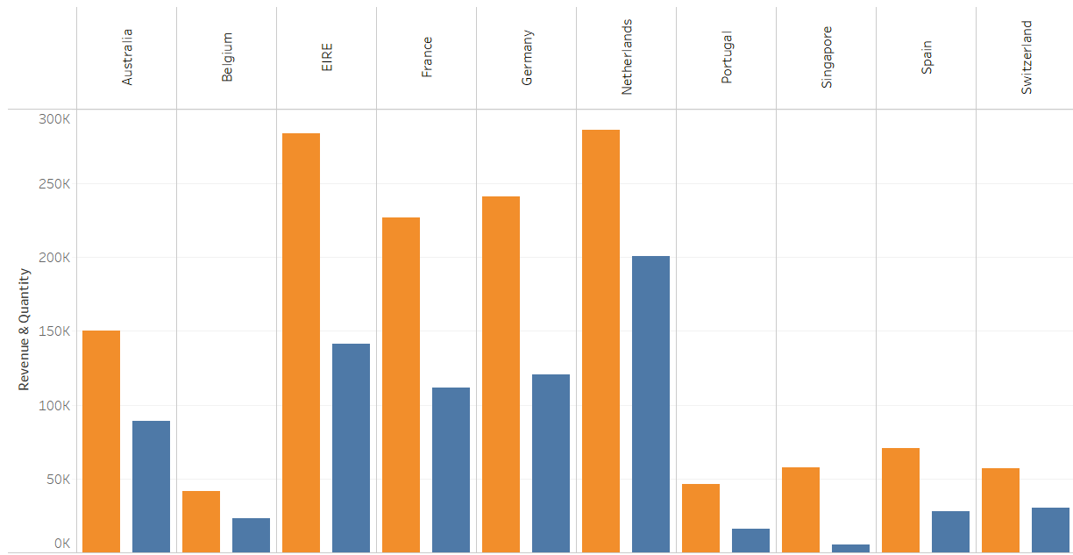

Data Visualization
Top 10 Country - Revenue & Quantity (Exclude United Kingdom)
Quantity and Revenue for each Country. The color shows details about Quantity and Revenue. The view is filtered on Country, which keeps 10 of 35 members
Country 'NETHERLANDS' shows the highest revenue & order quantity, followed by Country 'EIRE’
Country which makes the lowest revenue is 'BELGIUM’
Country 'SINGAPORE’ shows less sold quantity, but made a highest profit than 'BELGIUM'

Slide 8
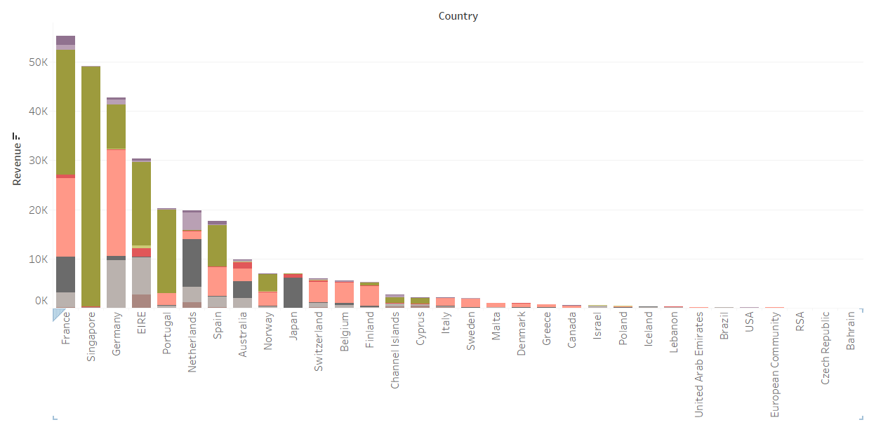
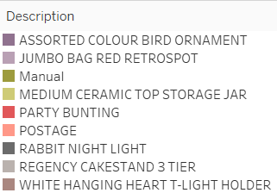
Data Visualization
Top 10 Product & Country Vs Revenue (Exclude United Kingdom)
Sum of Revenue for each Country. Color shows details about Description. The view is filtered on Description and Country. The Description filter keeps 10 of 3,887 members. The Country filter keeps 34 of 35 members
Product ‘Manual’ made a highest revenue across most of the country followed by the product ‘‘Postage’

Slide 9
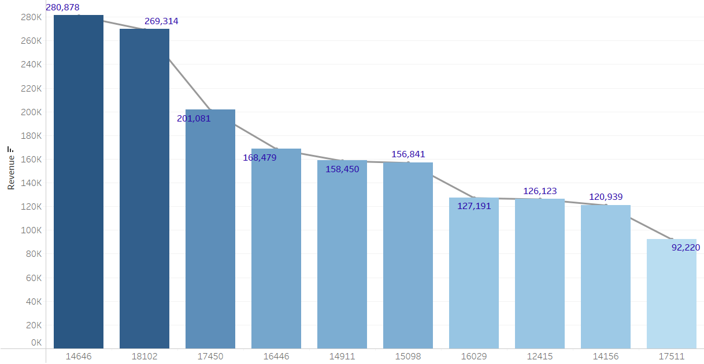

Data Visualization
Top 10 Revenue Making Customers
Sum of Revenue for each Customer ID. The view is filtered on Customer ID, which keeps 10 of 4,368 members
Customer who made the highest revenue is ID 14646, followed by the customer ID 18102
Customer who made the 10th least revue is ID 17511
The plot shows a decreasing trend

Slide 10
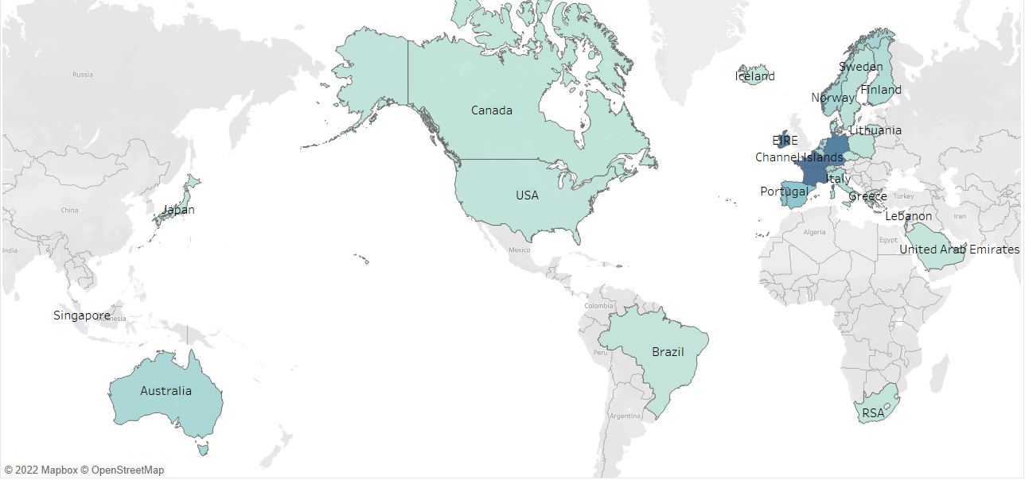

Data Visualization
Country Wise Revenue & Unit price(Exclude United Kingdom)
Country 'FRANCE ' shows the highest sold unit price (42871), followed by the Country 'GERMENY' (37666)
Country 'SAUDI ARABIA’ shows the least sold quantity (270)

Slide 11
Insights and Recommendation
Monthly Revenue [2011]
As per the line plot, we infer an increasing trend but, in the month of ‘December’, again a decreasing trend is noticed, the company can reduce the quantity or can give additional discounts since December month is known for seasonal days
The company can increase the quantity in the month of ‘September & November’ since it makes more revenue compared to other months
Country Wise Revenue & Unit price
Company can increase the production quantity for the country ‘France’ and ‘Germany’ and can decrease making the production unit in ‘Saudi Arabia’ and can try to make Campine or Social media advertisements to know about the people in demand requirements and to showcase their products
Top 10 Product & Country Vs Revenue
The company can import more ‘Manual’ & ‘Postage’ products in France and Singapore country
Country Bahrain makes the least revenue on the product Regency Cake stand and 3 Tier and company can give introduce discount coupons for the customer to purchase more quantity
Top 10 Revenue-Making Customers
For customer who makes more revenue company can introduce cashback, coupons, reward points
For customer who makes the least revenue company can introduce buy and get an offer and need to check the delivery time of the product and can introduce a feedback poll
Top 10 Country - Revenue & Quantity
The company can increase the product quantity in the ‘Netherlands’ country since they make the highest revenue followed by the Country 'EIRE’

